Slide 1
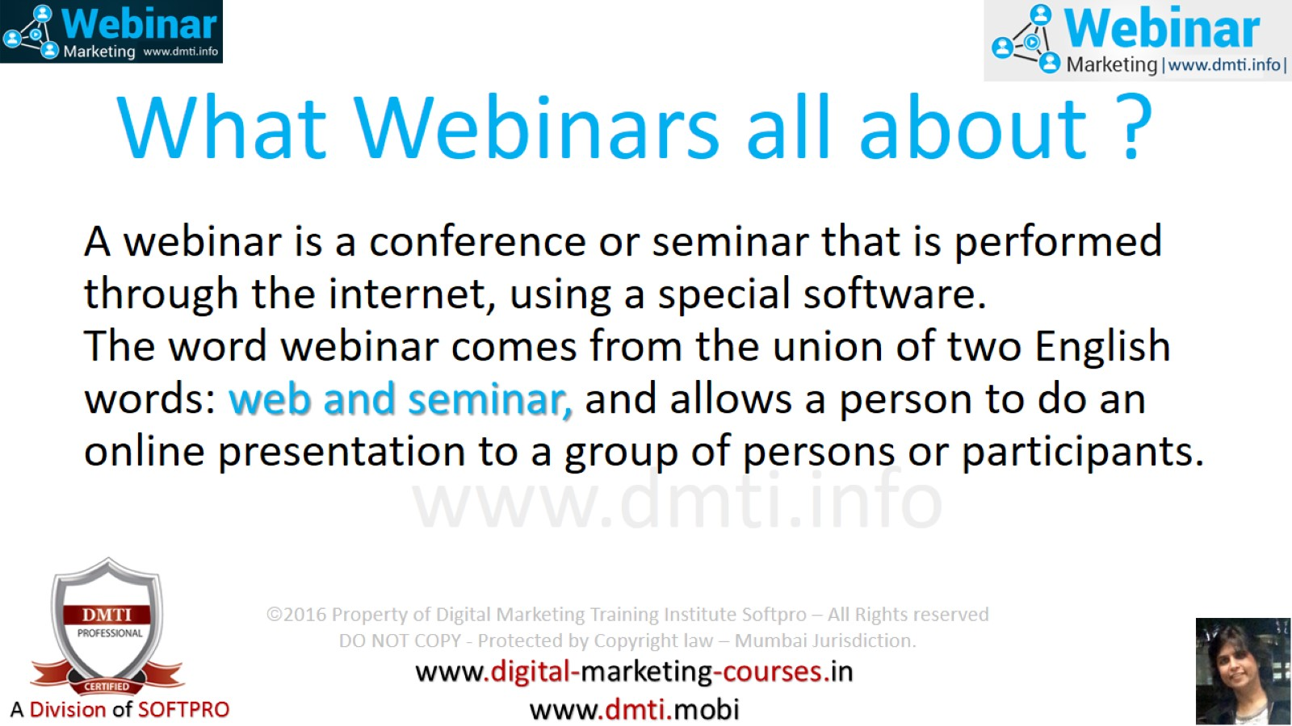
What Webinars all about ?

Slide 2
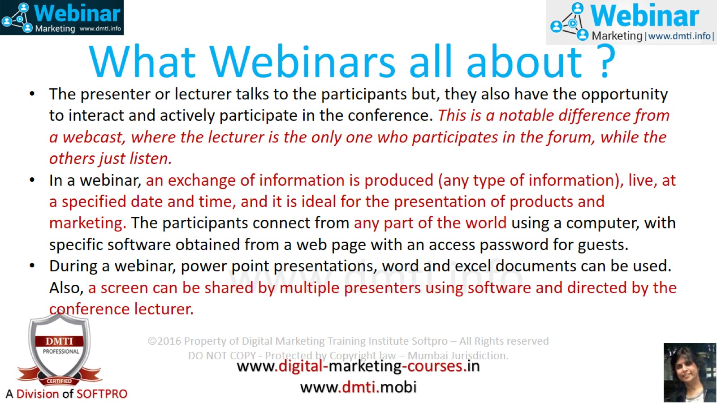
What Webinars all about ?

Slide 3
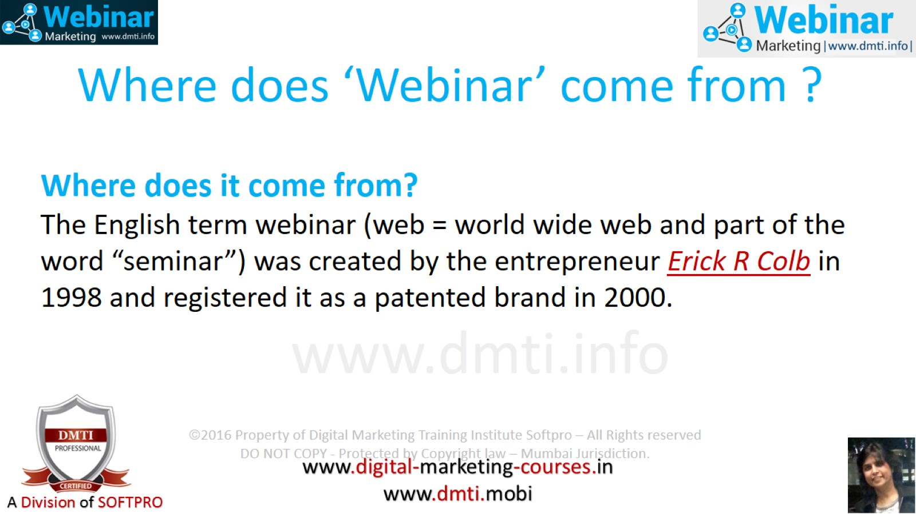
Where does ‘Webinar’ come from ?

Slide 4
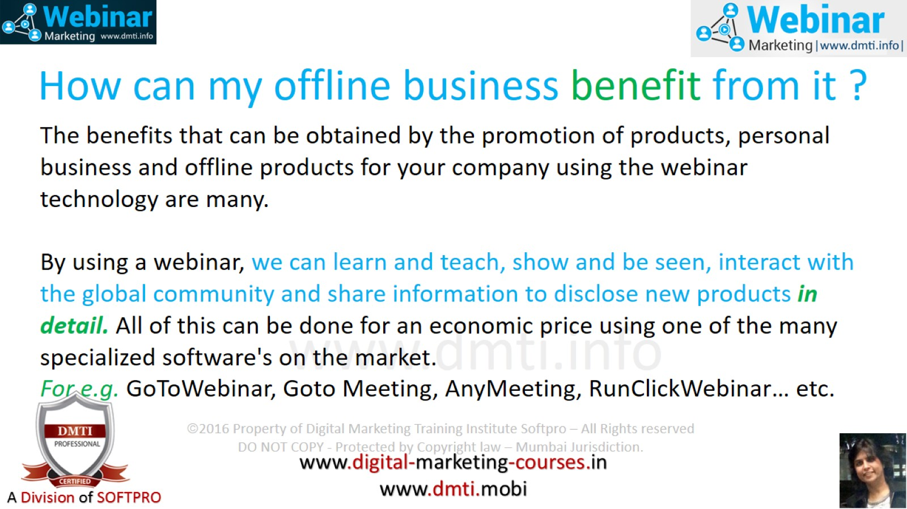
How can my offline business benefit from it ?

Slide 5
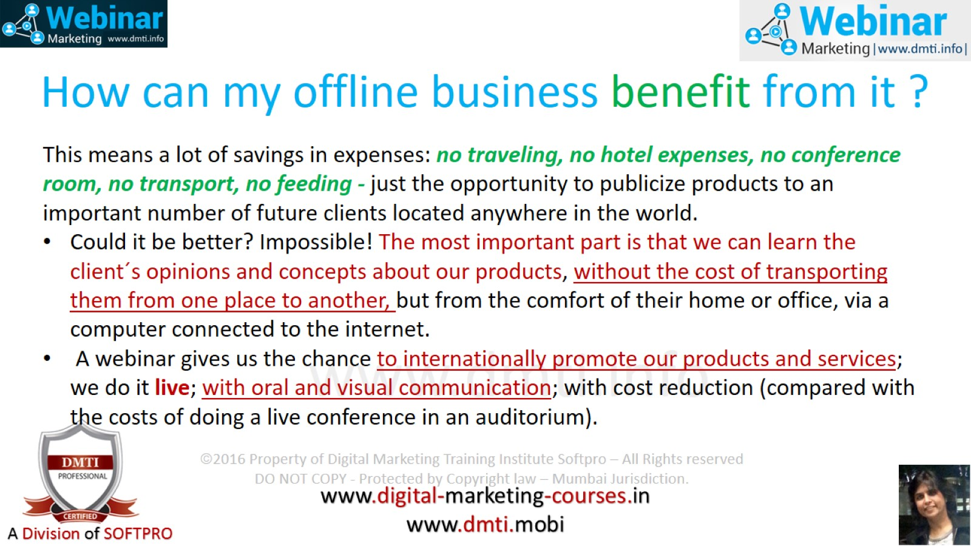
How can my offline business benefit from it ?

Slide 6
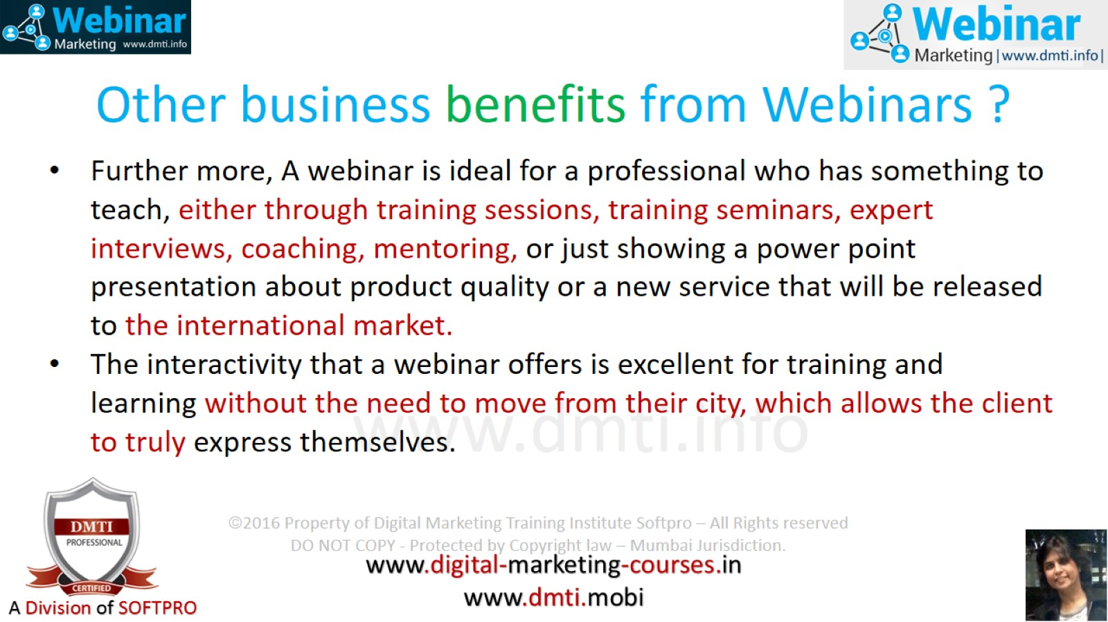
Other business benefits from Webinars ?

Slide 7
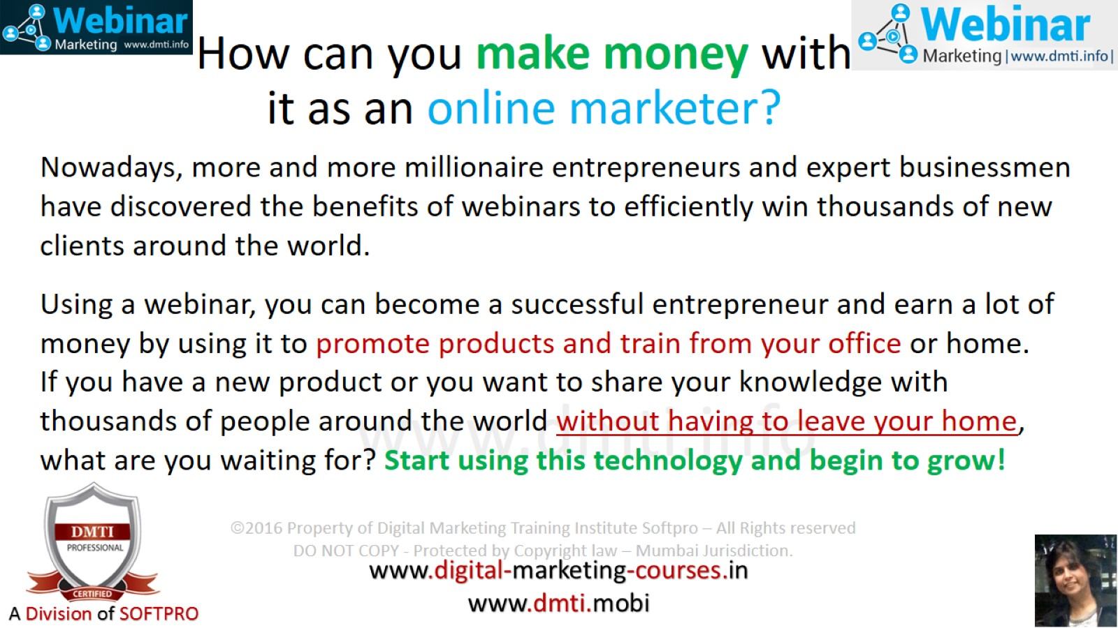
How can you make money with it as an online marketer?

Slide 8
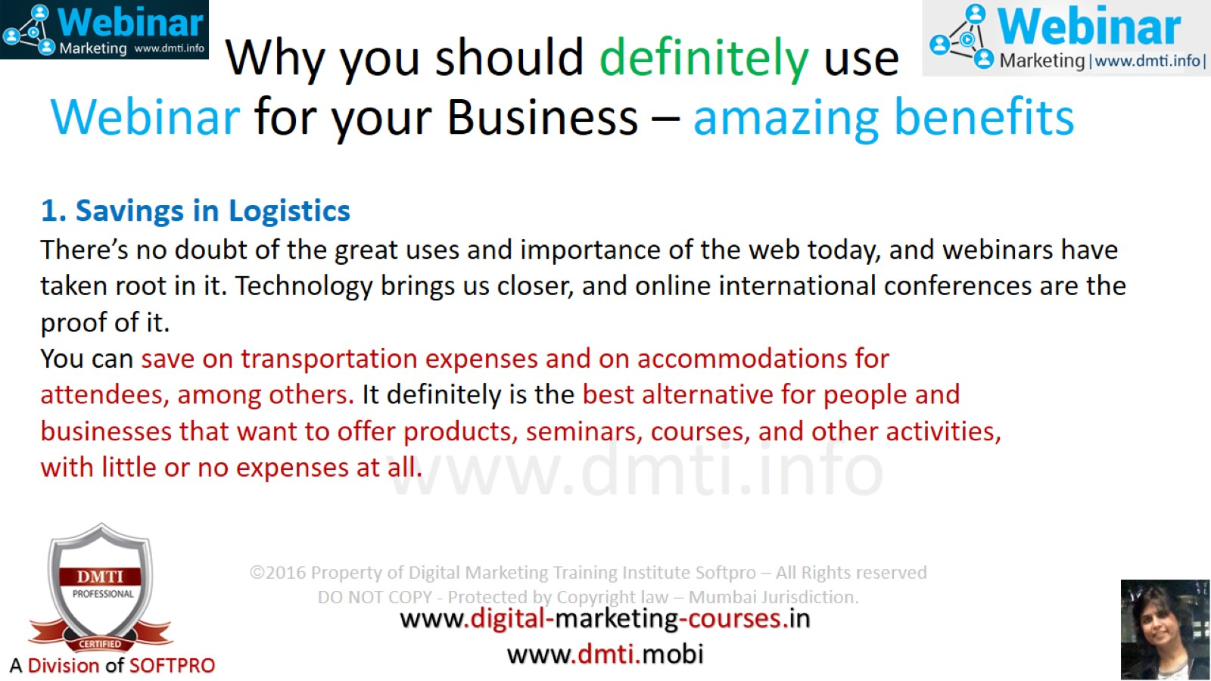
Why you should definitely use Webinar for your Business – amazing benefits

Slide 9
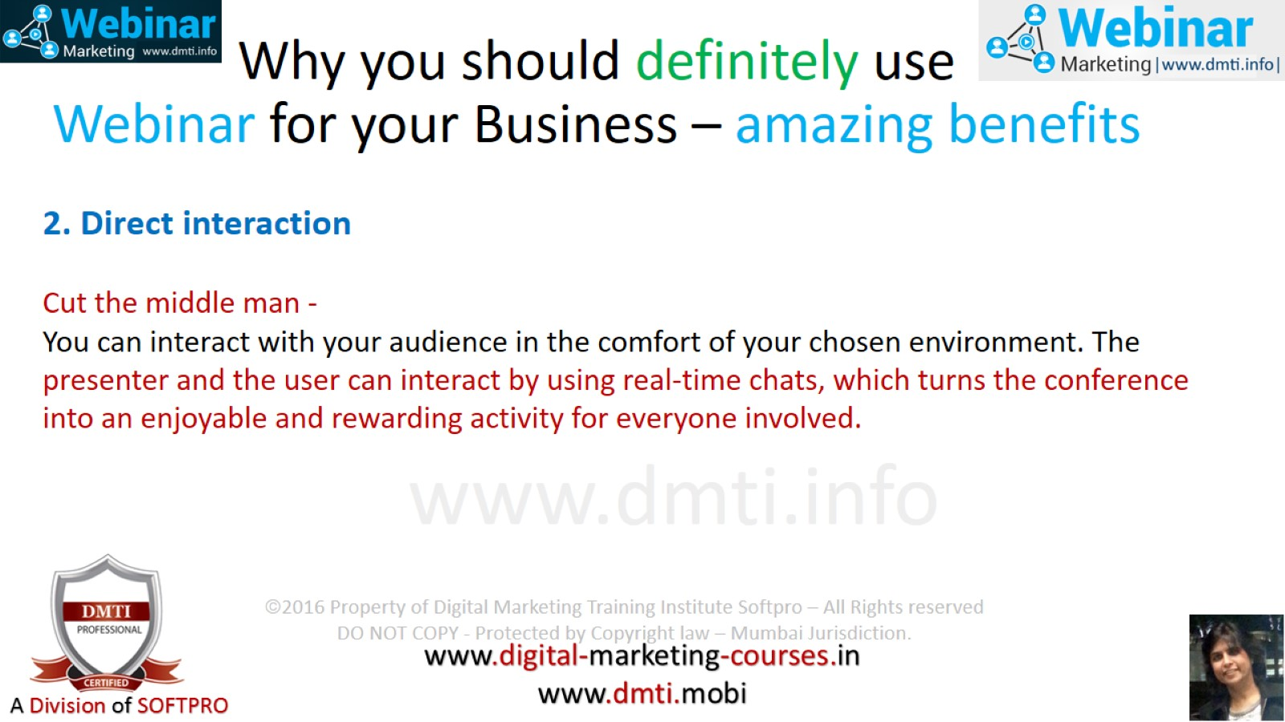
Why you should definitely use Webinar for your Business – amazing benefits

Slide 10
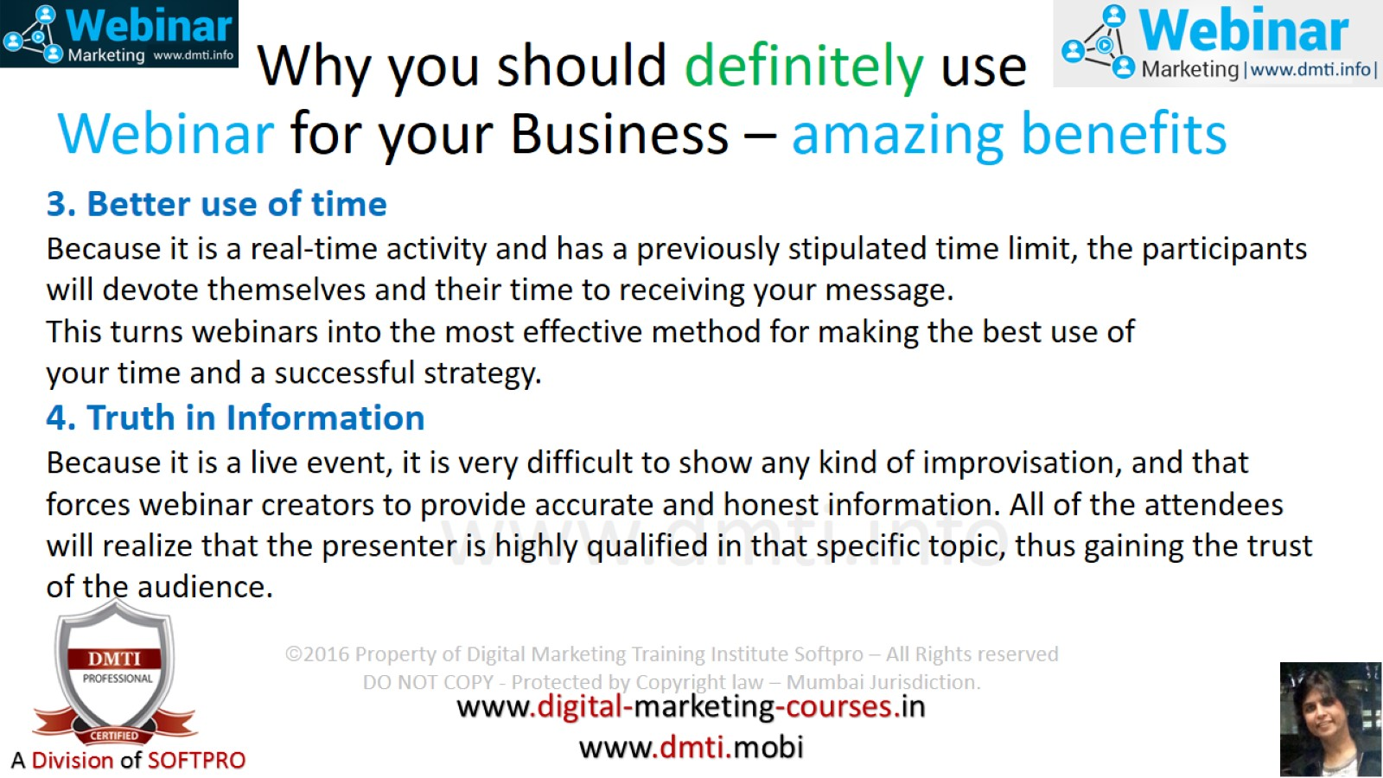
Why you should definitely use Webinar for your Business – amazing benefits

Slide 11
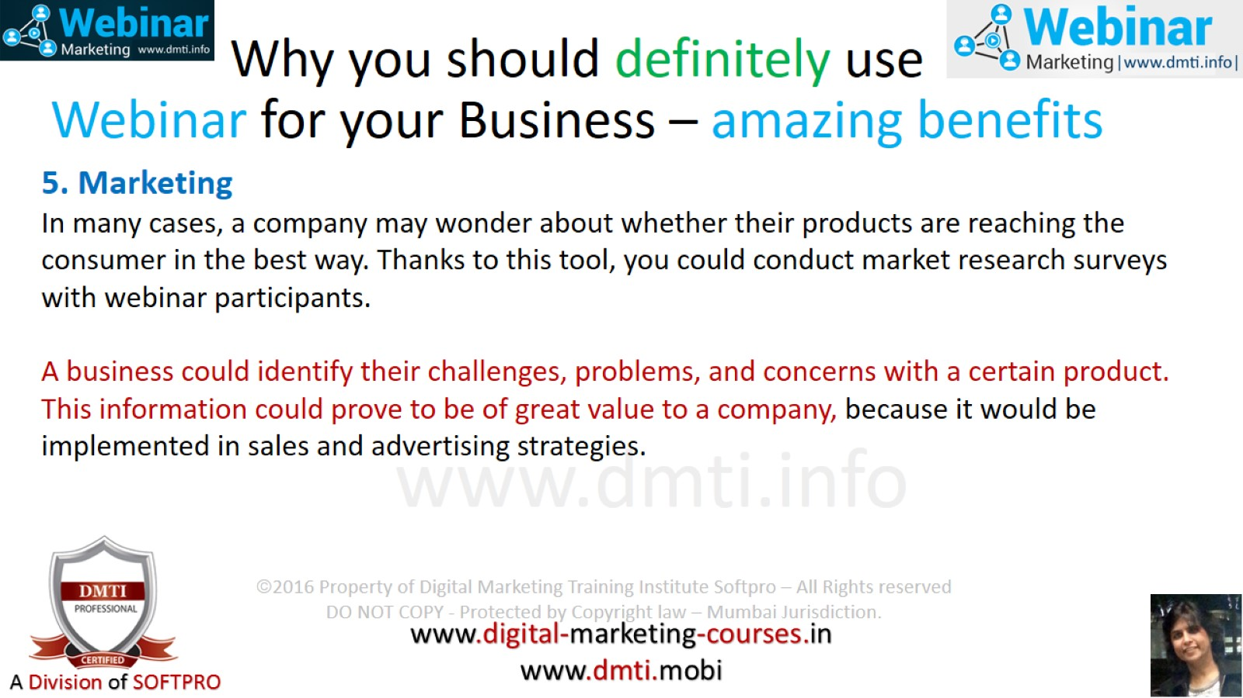
Why you should definitely use Webinar for your Business – amazing benefits

Slide 12
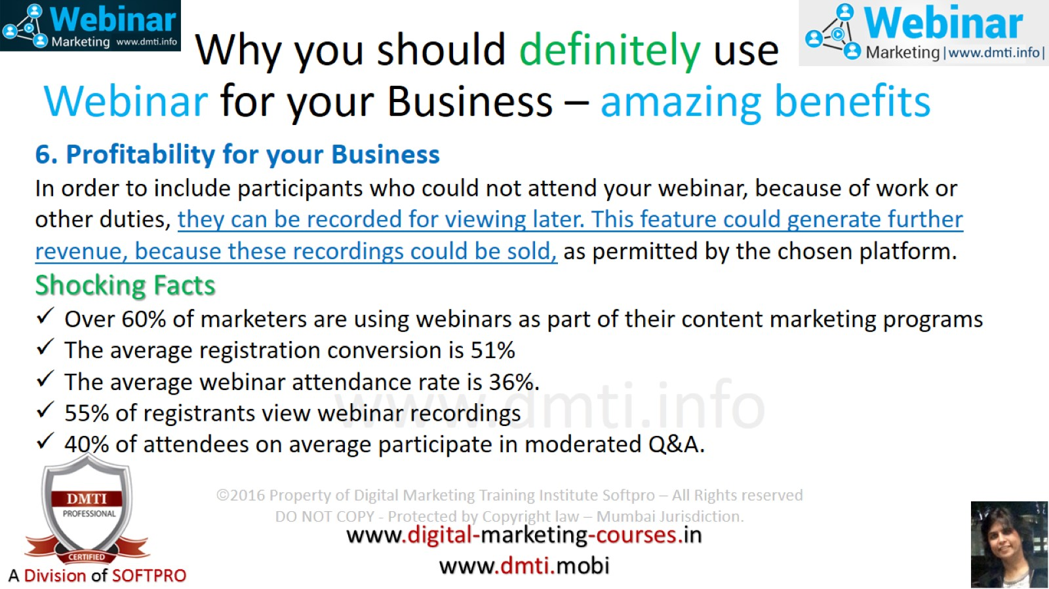
Why you should definitely use Webinar for your Business – amazing benefits

Slide 13
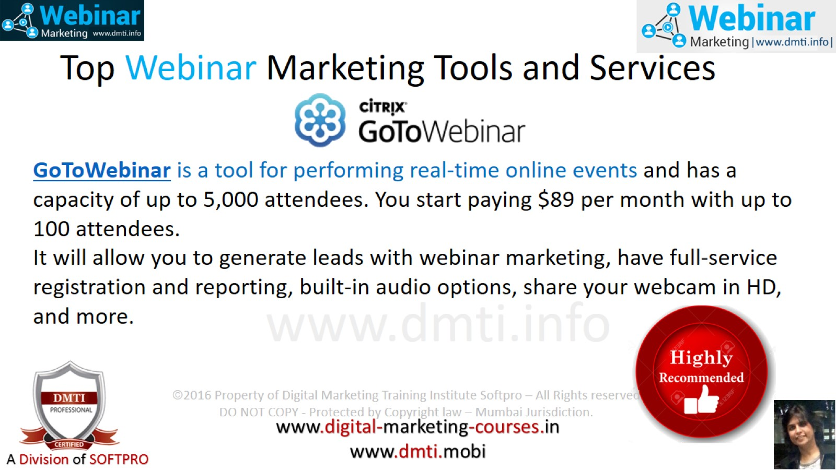
Top Webinar Marketing Tools and Services

Slide 14
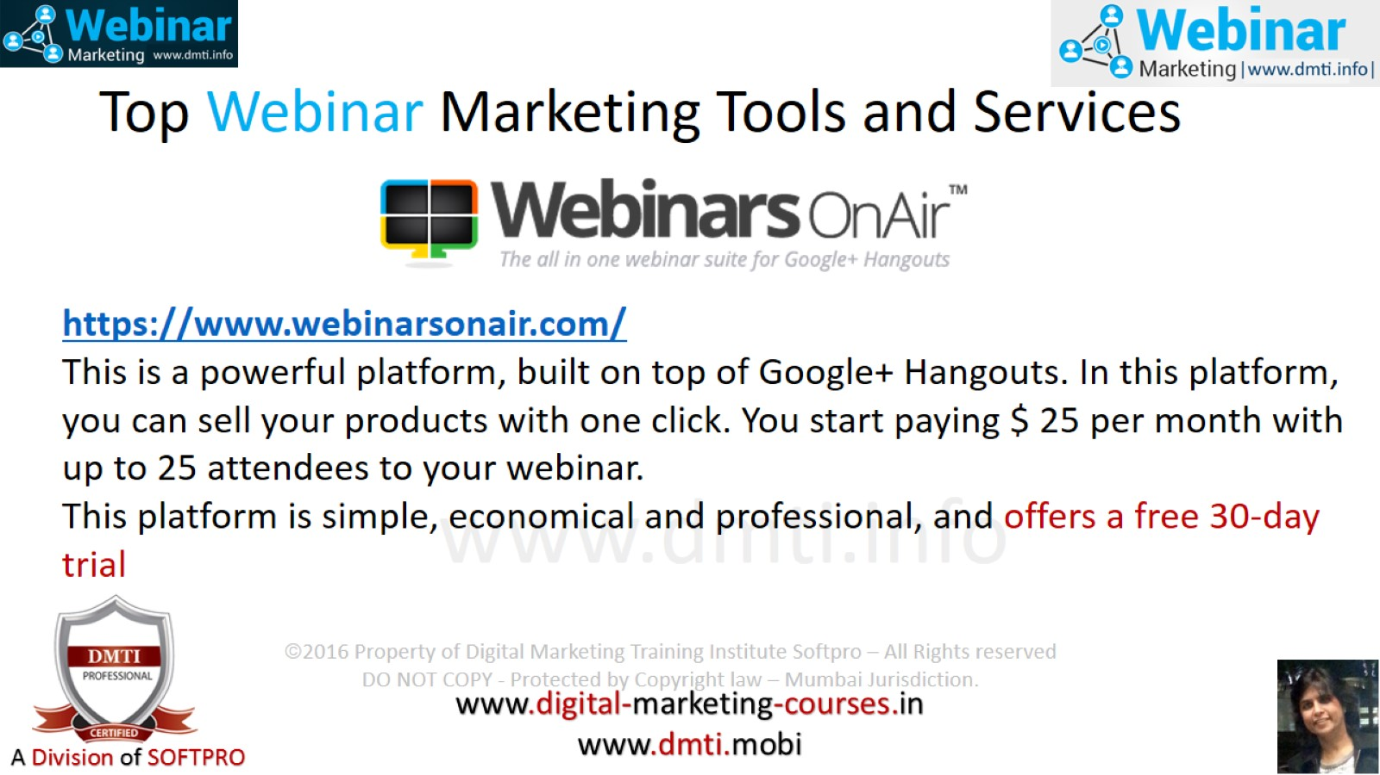
Top Webinar Marketing Tools and Services

Slide 15
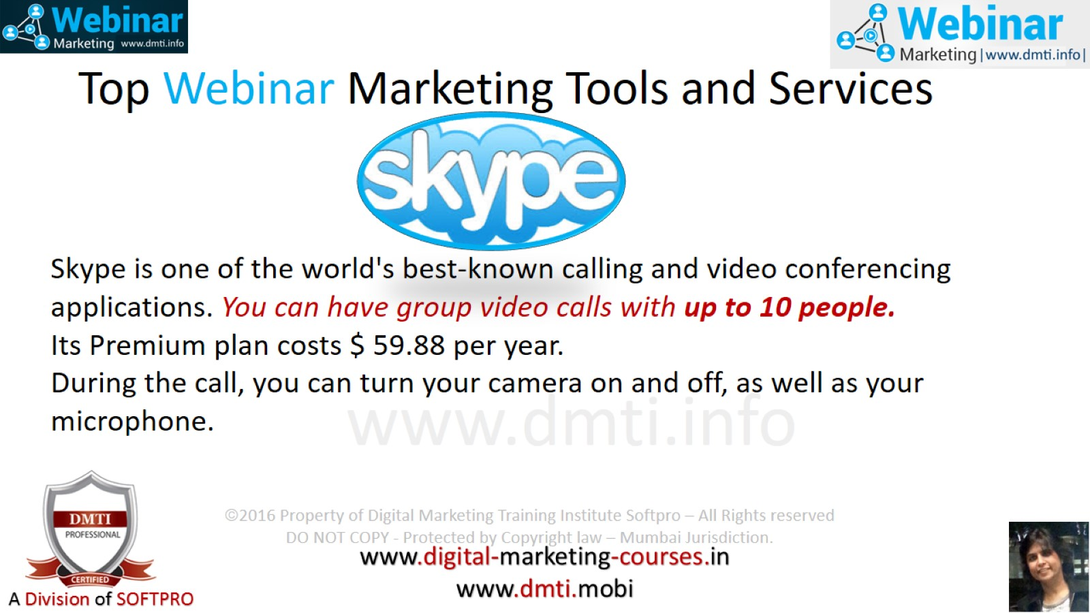
Top Webinar Marketing Tools and Services

Slide 16
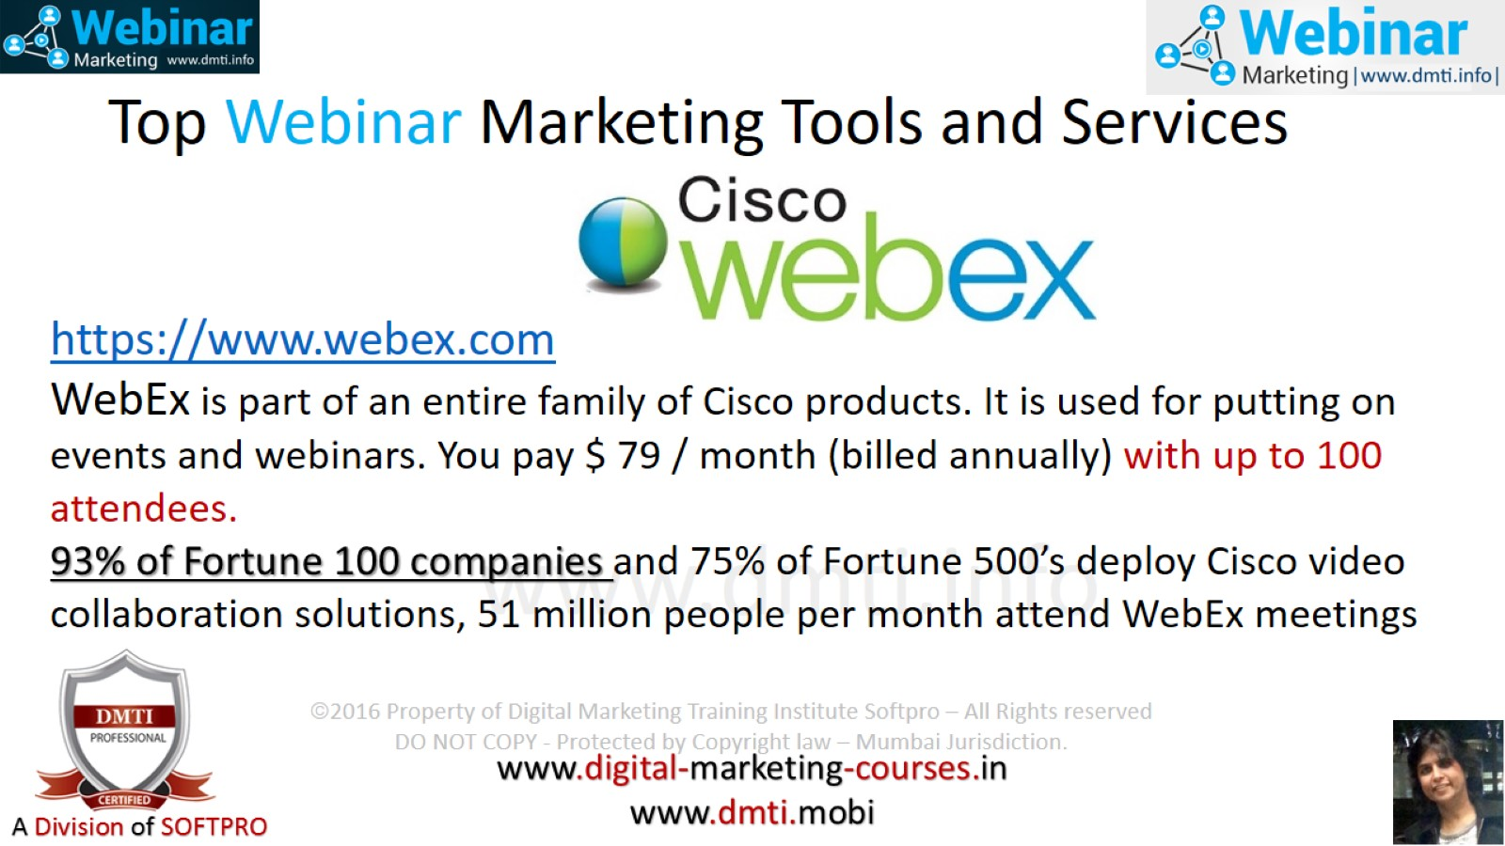
Top Webinar Marketing Tools and Services

Slide 17
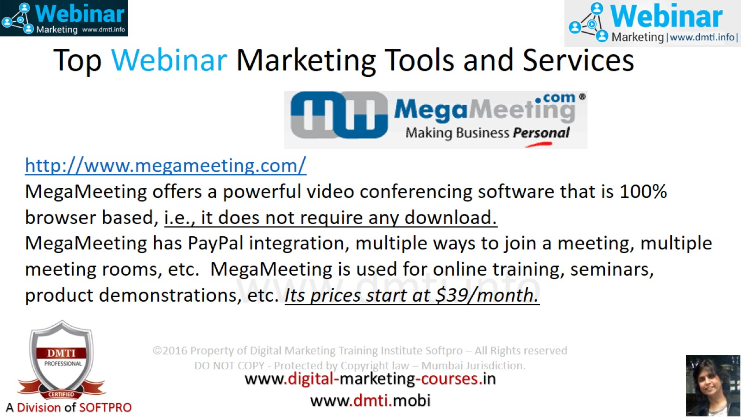
Top Webinar Marketing Tools and Services

Slide 18
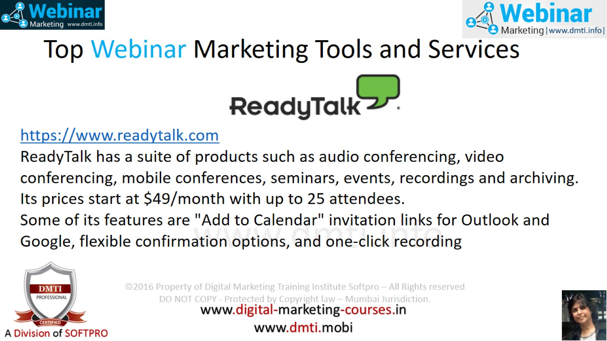
Top Webinar Marketing Tools and Services

Slide 19
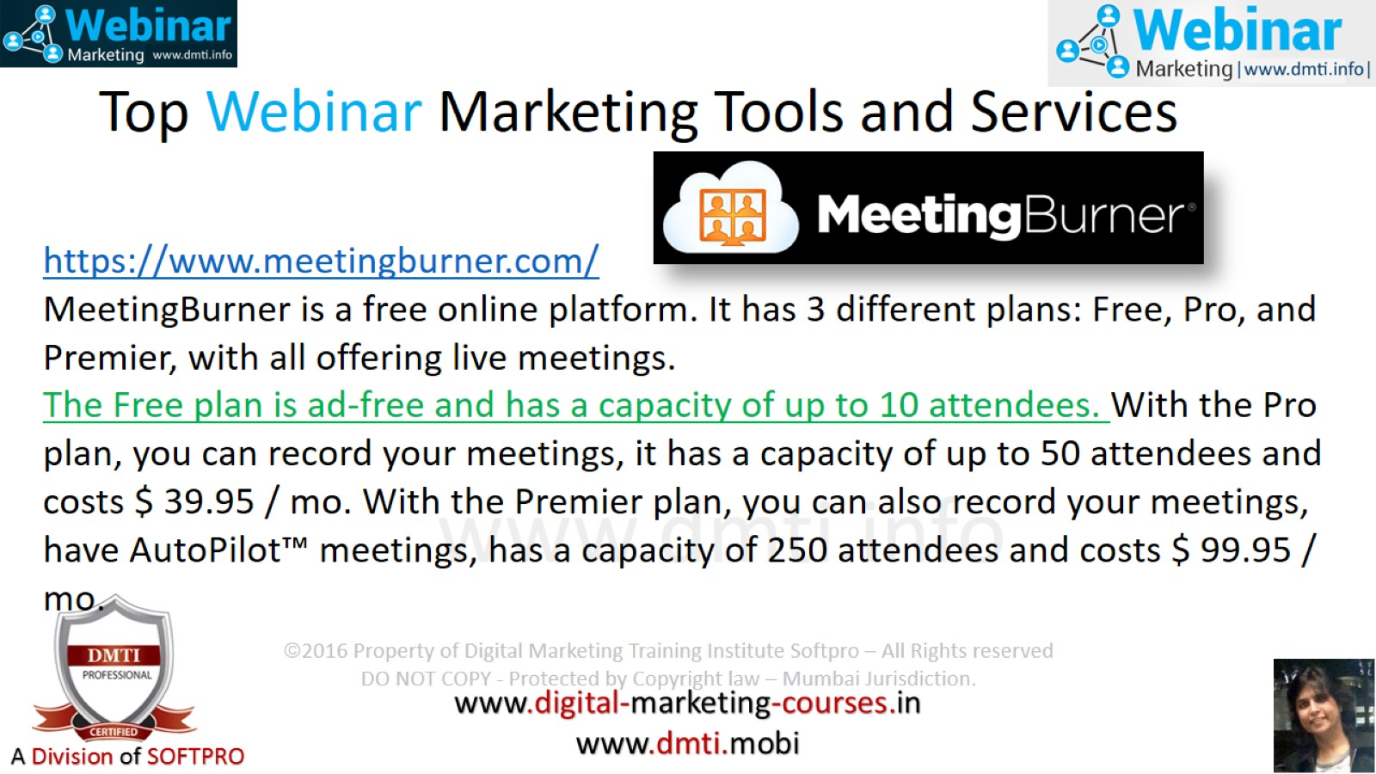
Top Webinar Marketing Tools and Services

Slide 20
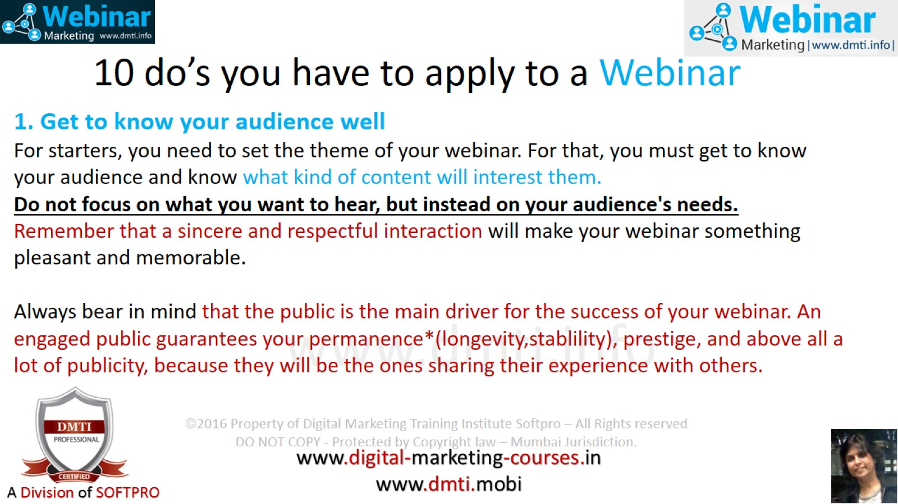
10 do’s you have to apply to a Webinar

Slide 21
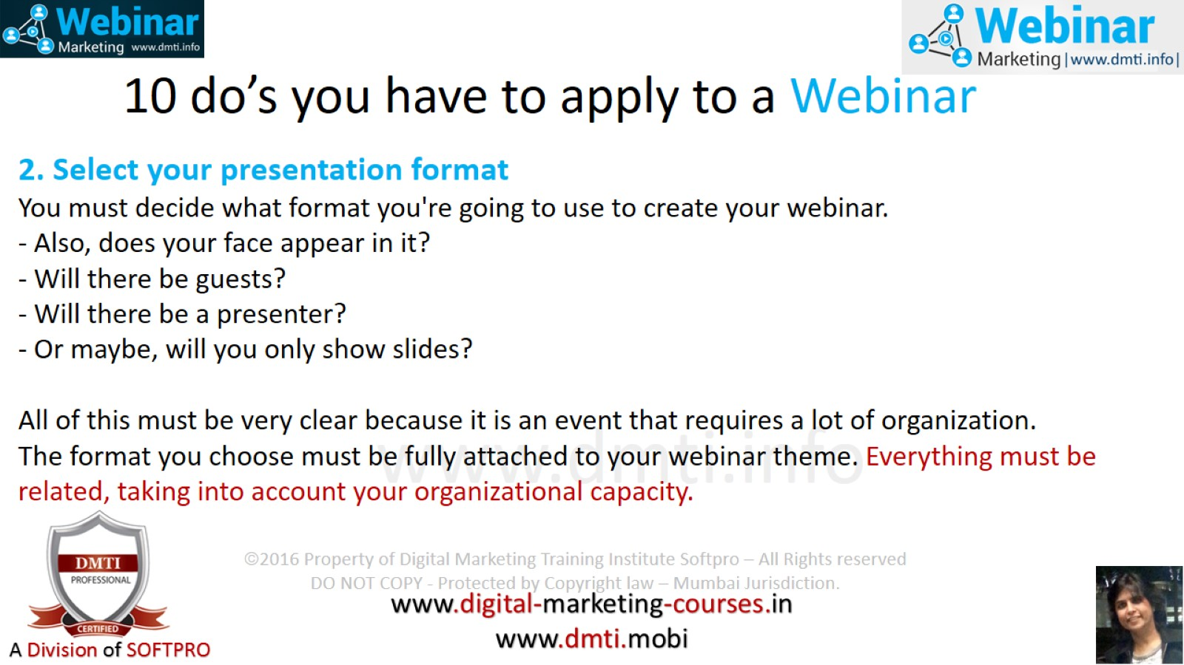
10 do’s you have to apply to a Webinar

Slide 22
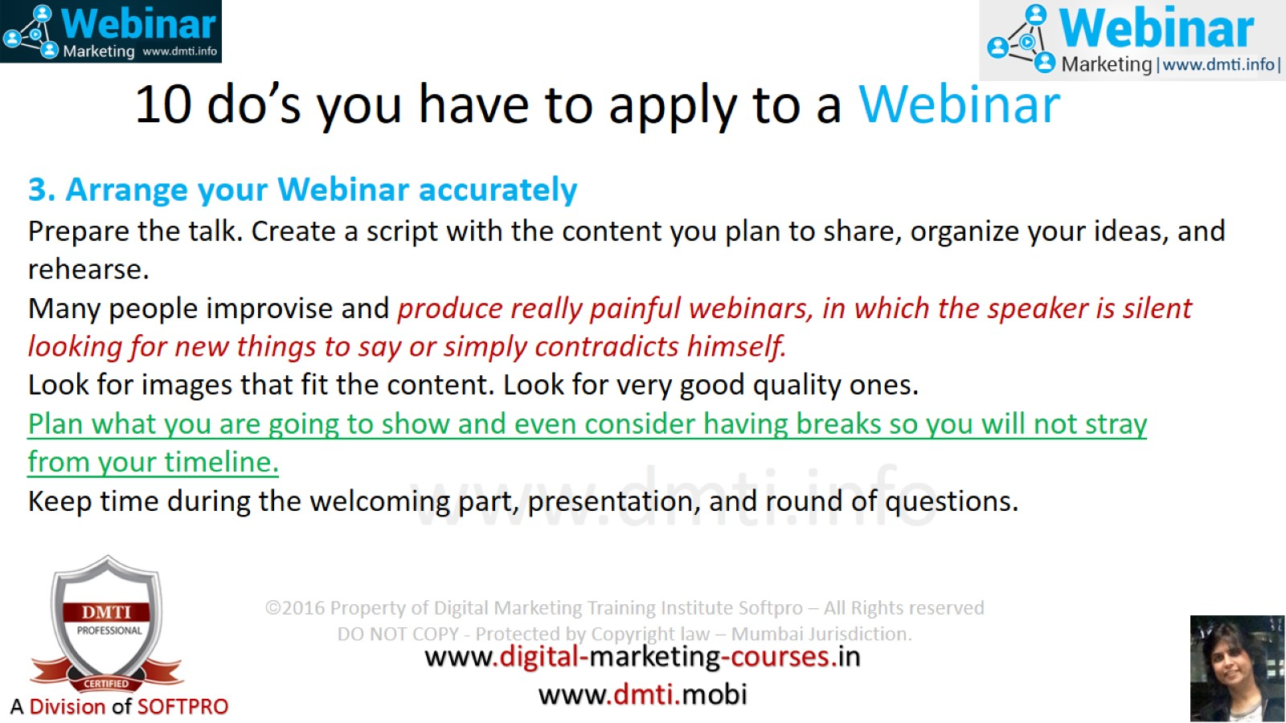
10 do’s you have to apply to a Webinar

Slide 23
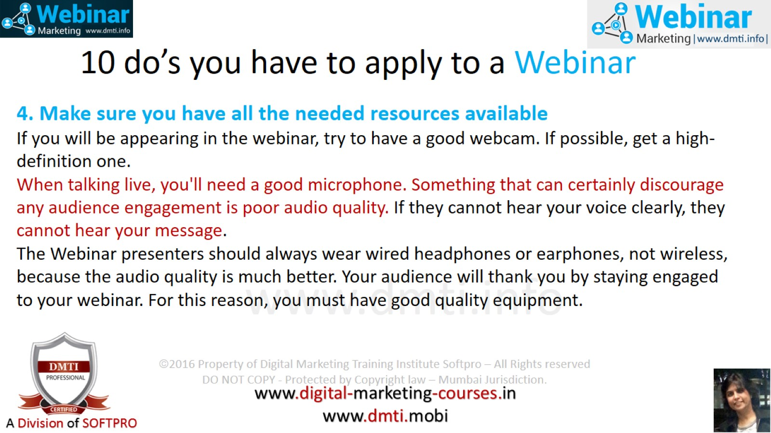
10 do’s you have to apply to a Webinar

Slide 24
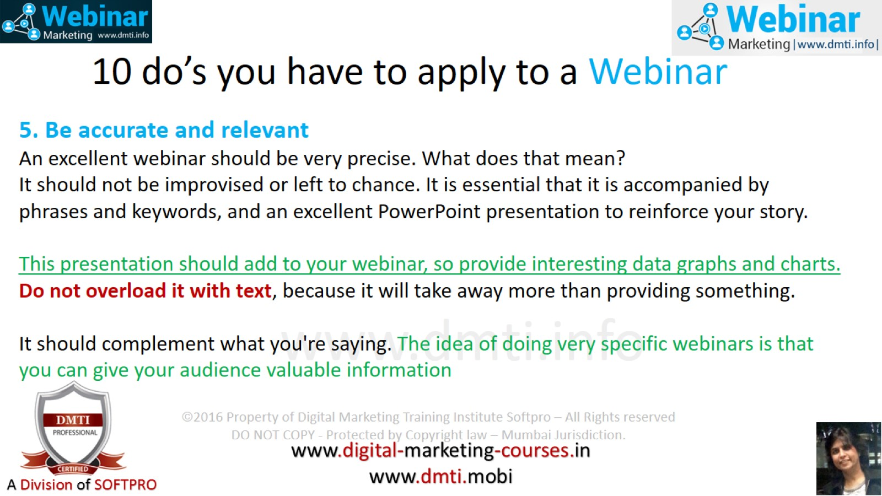
10 do’s you have to apply to a Webinar

Slide 25
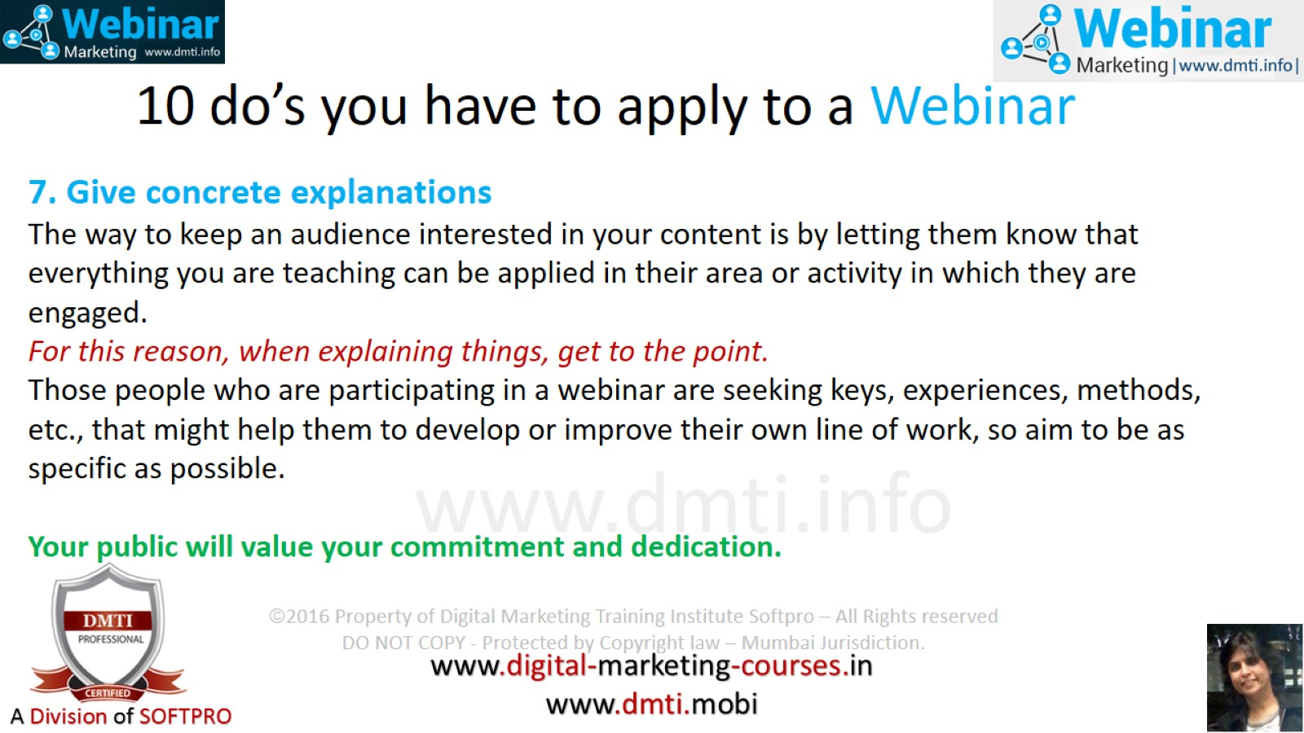
10 do’s you have to apply to a Webinar

Slide 26
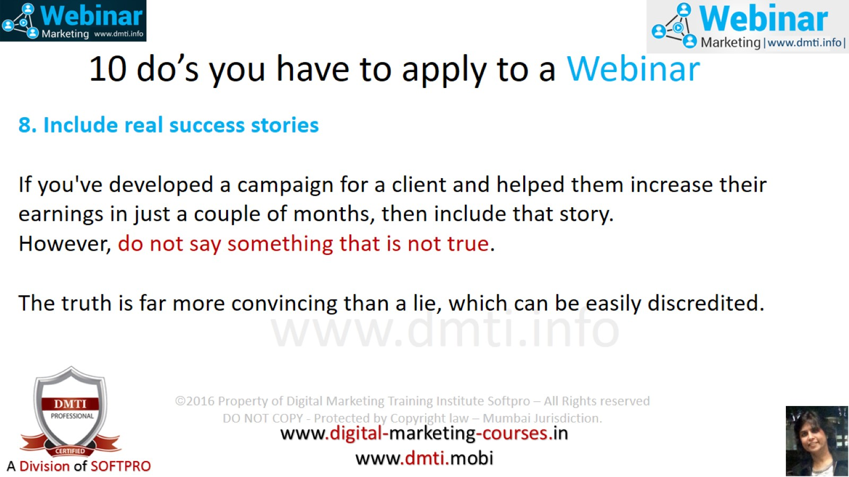
10 do’s you have to apply to a Webinar

Slide 27
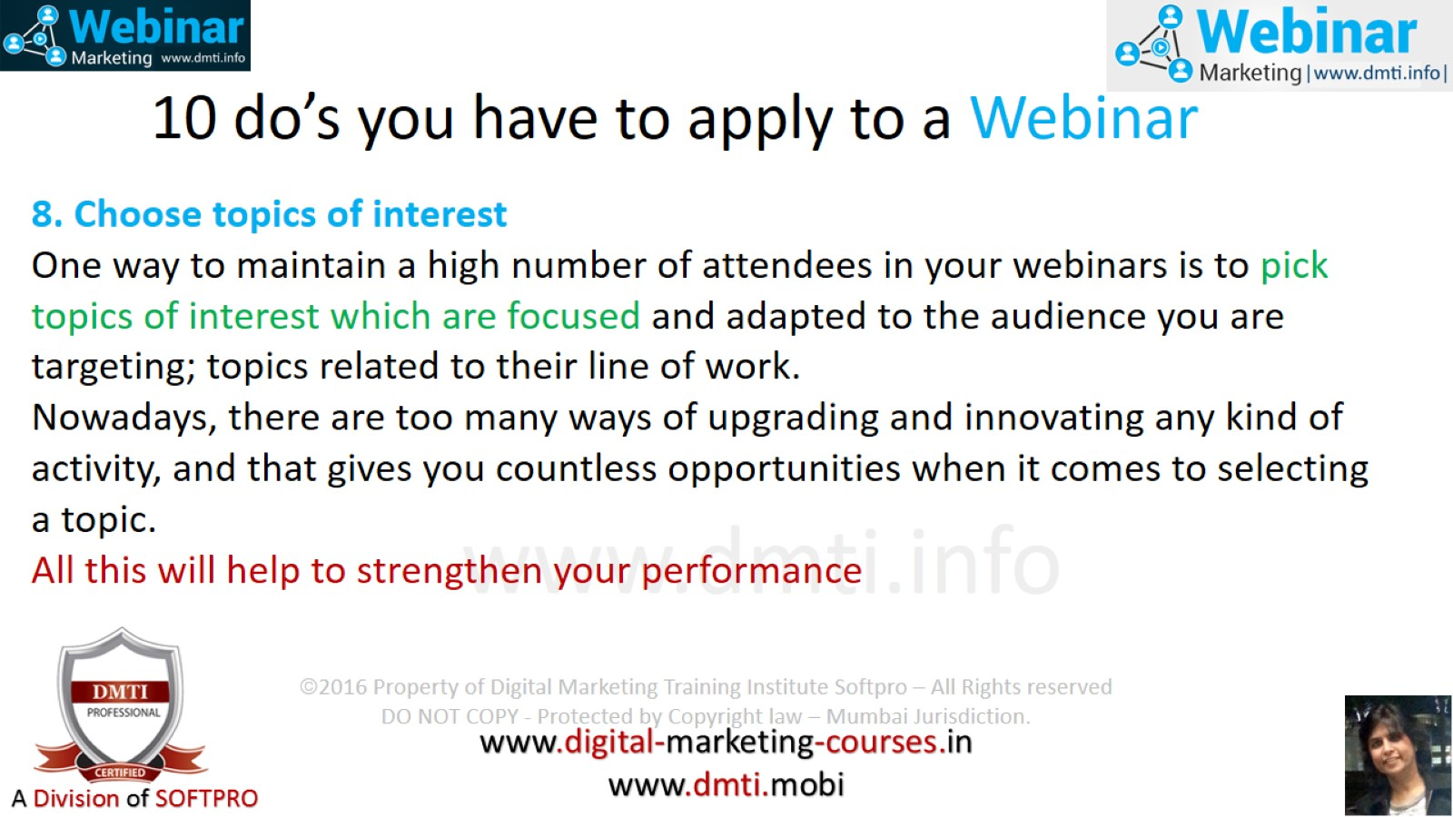
10 do’s you have to apply to a Webinar

Slide 28
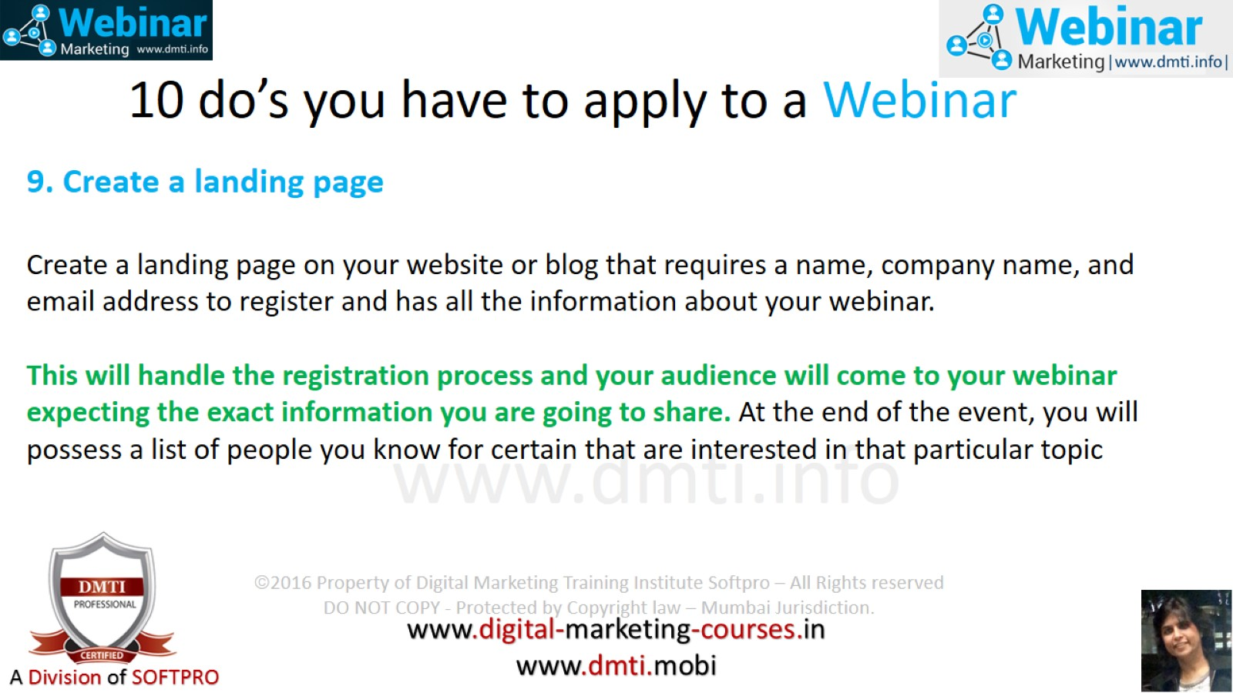
10 do’s you have to apply to a Webinar

Slide 29
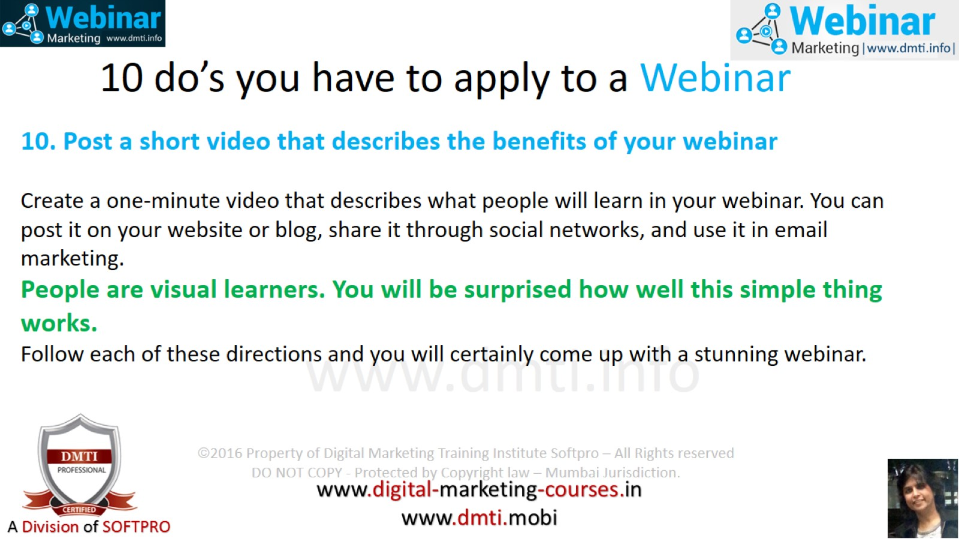
10 do’s you have to apply to a Webinar

Slide 30
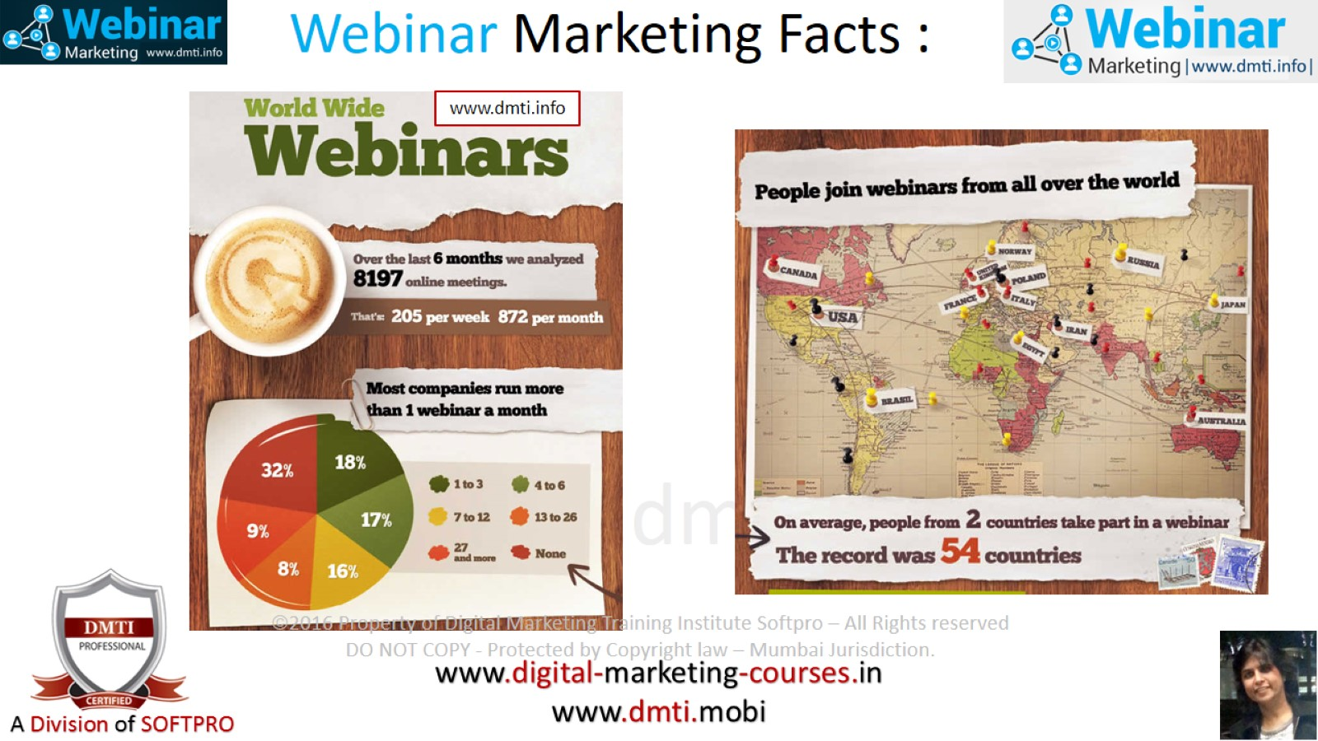
Webinar Marketing Facts :

Slide 31
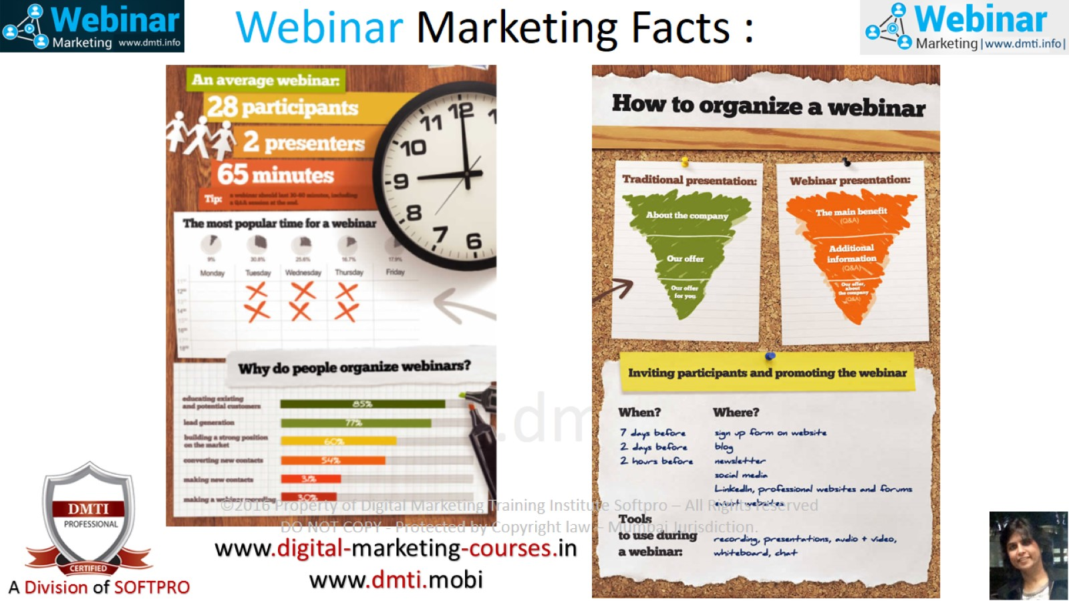
Webinar Marketing Facts :

Slide 32
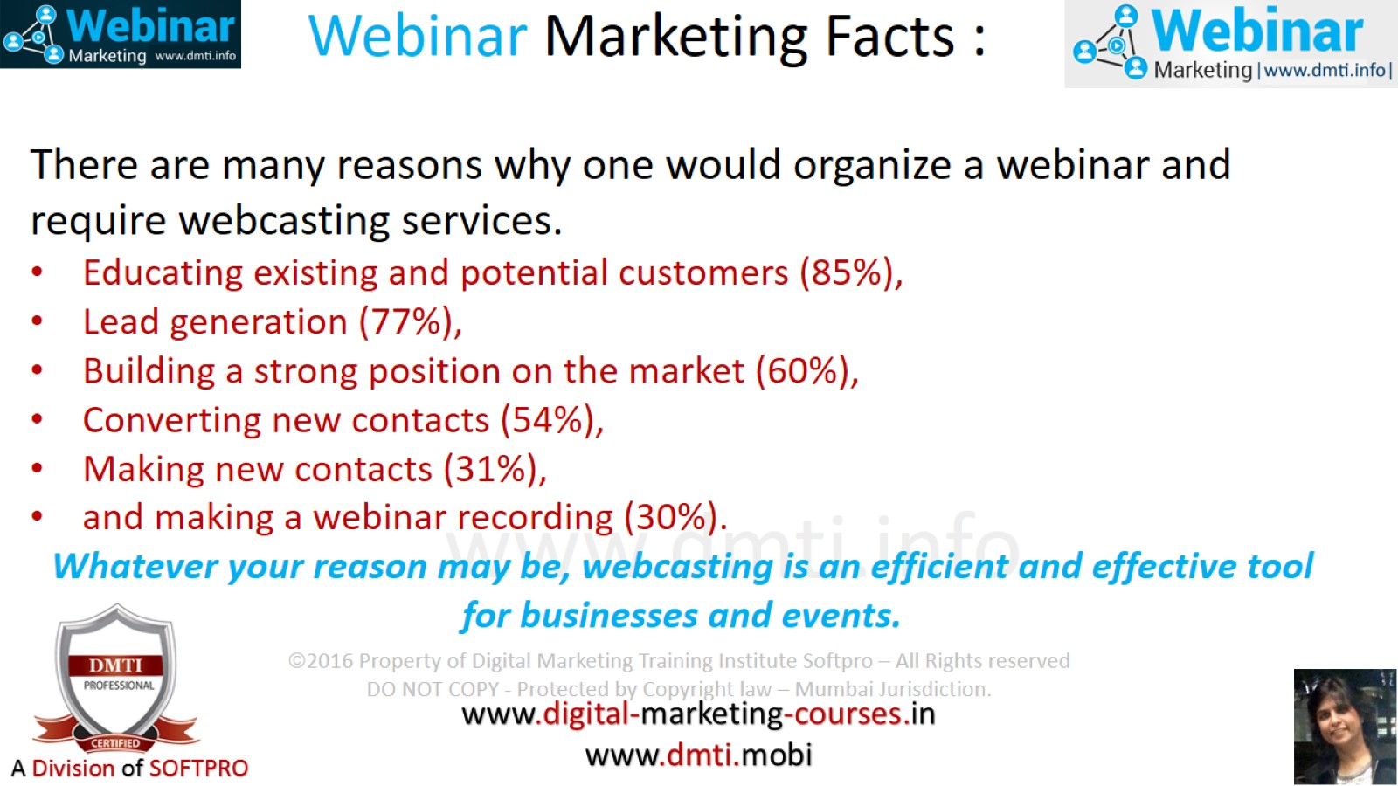
Webinar Marketing Facts :

